Slide 1
Lesson objective
PBiS focus
Respect – each other
Achieve – attempting all tasks
Title: Dot plots
Aim:
Create dot plots
Identify when to use dot plots
Plan:
Purpose and features
Skills practice
Need whiteboards and calculators

Slide 2
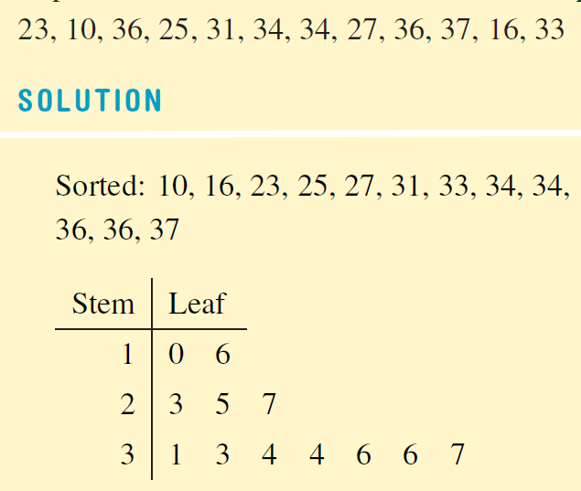
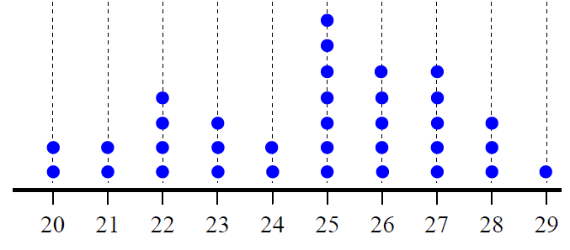
Which graph?
Where there is a large range and few repeats, a Stem and Leaf is more informative.
When the leaves contain one digit each, are put in order, are lined up in a grid, and there is a key, it is a Stem and Leaf diagram.
Where there is a small range and lots of repeats, a Dot Plot is more informative.
When there is a scale at the bottom, and the dots are lined up on the grid, it is a Dot Plot.
10, 36, 23, 31, 25, 33, 16, 34, 27, 34, 37, 36
Scale:
means 23m
25, 28, 23, 24, 23, 24, 27, 26, 25, 25, 22, 22, 20, 29, 25, 26, 27,
26, 28, 21, 25, 25, 27, 21, 25, 27, 26, 27, 22, 26, 23, 20, 22, 28

Slide 3
Which graph?
Where there is a ……………………. and ……………………., a Stem and Leaf is more informative.
When the leaves contain ……………………., are ……………………., are ……………………., and ……………………., it is a Stem and Leaf diagram.
Where there is a ……………………. and ……………………., a Dot Plot is more informative.
When there is a scale at the bottom, and the …………………. …………………. on the grid, it is a Dot Plot.
10, 36, 23, 31, 25, 33, 16, 34, 27, 34, 37, 36
Scale:
means 23m
25, 28, 23, 24, 23, 24, 27, 26, 25, 25, 22, 22, 20, 29, 25, 26, 27,
26, 28, 21, 25, 25, 27, 21, 25, 27, 26, 27, 22, 26, 23, 20, 22, 28
Notes:
Student Notes Page

Slide 4
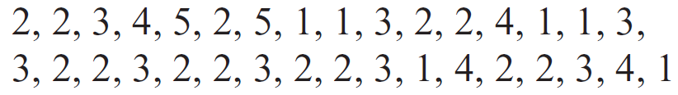
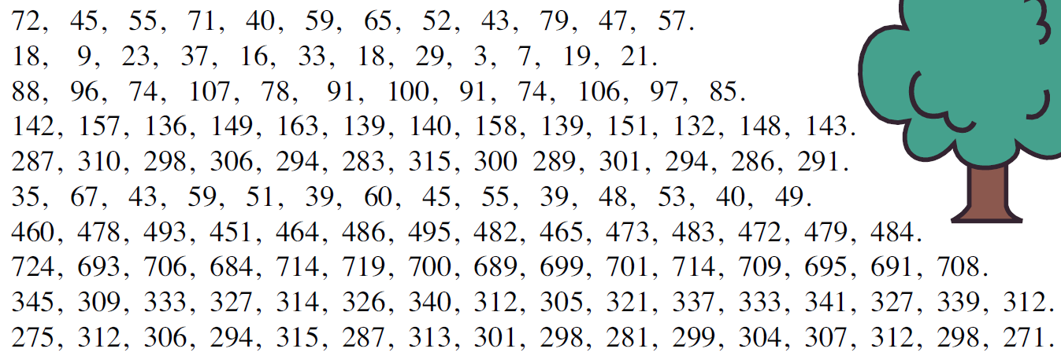
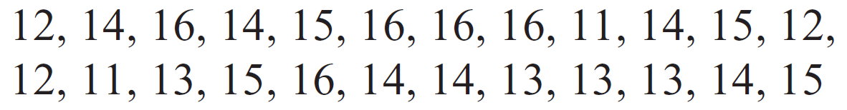
Dot Plot or Stem-and-Leaf?
How many repeats?
Small or large range?

Slide 5

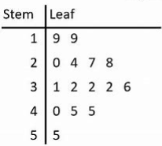
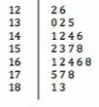
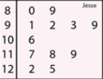
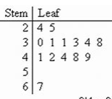
Stem and Leaf Diagrams
The stem contains the first part of each number
The leaves contain the last digit of each number
The numbers represented in this Stem and Leaf Diagram are:
19
19
20
24
27
28
31
32
32
32
36
Read out the numbers represented in these Stem and Leaf Diagrams with me
40
45
45
55

Slide 6
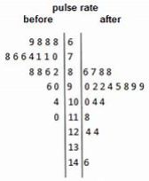
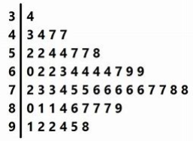
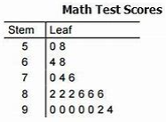
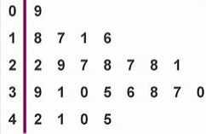
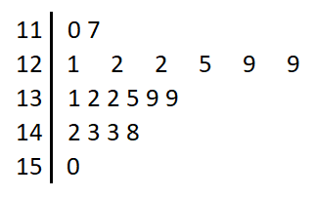
Stem and Leaf Diagrams
The stem contains the first part of each number
The leaves contain the last digit of each number
Numbers are ordered (lowest is closest) and equally spaced in a grid
✓
✓
✓
Not in order
Not equally spaced
✘
✘
✓

Slide 7
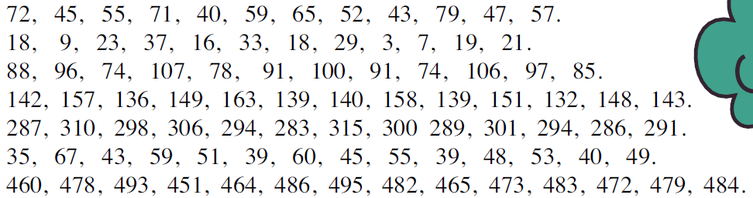
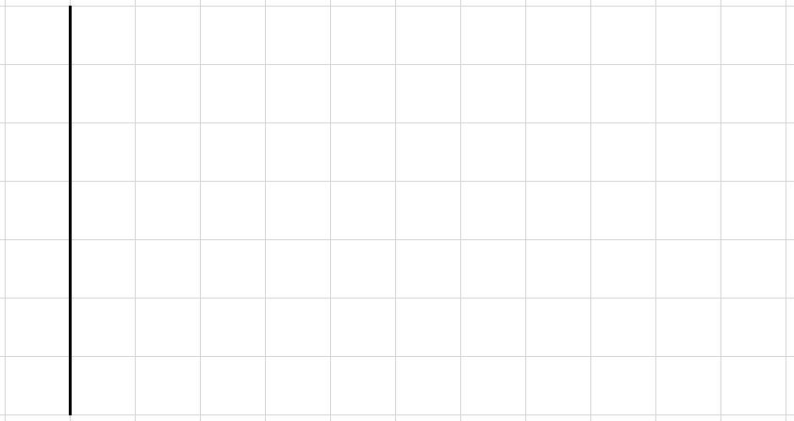

Putting data into a Stem and Leaf Diagram
Put the data in order
Set up the stem
Fill in the leaves
Write the Key
40, 43, 45, 47, 52, 55, 57, 59, 65, 71, 72, 79
4
5
6
7
0
3
5
7
2
5
7
9
5
Key:
1
2
9
means 52

Slide 8
Putting data into a Stem and Leaf Diagram
Put the data in order
Set up the stem
Fill in the leaves
Write the Key
40, 43, 45, 47, 52, 55, 57, 59, 65, 71, 72, 79
4
5
6
7
Key:
means _____

Slide 9

Putting data into a Stem and Leaf Diagram
Put the data in order
Set up the stem
Fill in the leaves
Write the Key
3, 7, 9, 16, 18, 18, 19, 21, 23, 29, 33, 37
0
1
2
3
3
7
9
6
8
8
9
1
3
9
Key:
3
7
means 21

Slide 10
Putting data into a Stem and Leaf Diagram
Put the data in order
Set up the stem
Fill in the leaves
Write the Key
0
1
2
3
Key:
means ____

Slide 11
Putting data into a Dot Plot
Draw scale to fit the highest and lowest numbers
Write the numbers on the lines
Fill in dots on the grid
1, 2, 1, 5, 3, 4, 3, 2, 1, 3, 2, 5, 3, 4, 2, 1, 2, 1, 2, 1, 3, 4, 3, 2, 5, 4, 1, 2, 1, 3
1 2 3 4 5

Slide 12
Putting data into a Dot Plot
Draw scale to fit the highest and lowest numbers
Write the numbers on the lines
Fill in dots on the grid
1, 2, 1, 5, 3, 4, 3, 2, 1, 3, 2, 5, 3, 4, 2, 1, 2, 1, 2, 1, 3, 4, 3, 2, 5, 4, 1, 2, 1, 3
1 2 3 4 5

Slide 13
Putting data into a Dot Plot
Draw scale to fit the highest and lowest numbers
Write the numbers on the lines
Fill in dots on the grid
4, 7, 5, 5, 6, 4, 7, 8, 2, 5, 6, 6, 5, 5, 7, 5, 7, 5, 3, 6
2 3 4 5 6 7 8

Slide 14
Putting data into a Dot Plot
Draw scale to fit the highest and lowest numbers
Write the numbers on the lines
Fill in dots on the grid
4, 7, 5, 5, 6, 4, 7, 8, 2, 5, 6, 6, 5, 5, 7, 5, 7, 5, 3, 6
2 3 4 5 6 7 8

Slide 15
Putting data into a Dot Plot
Draw scale to fit the highest and lowest numbers
Write the numbers on the lines
Fill in dots on the grid
20, 22, 21, 21, 23, 22, 20, 20, 21, 21, 21, 22, 20, 21, 20, 21
On your whiteboards
20 21 22 23

Slide 16
Putting data into a Dot Plot
Draw scale to fit the highest and lowest numbers
Write the numbers on the lines
Fill in dots on the grid
7, 9, 11, 12, 13, 15, 12, 10, 9, 12, 11, 9, 11, 10, 11
On your whiteboards
7 8 9 10 11 12 13 14 15

Slide 17
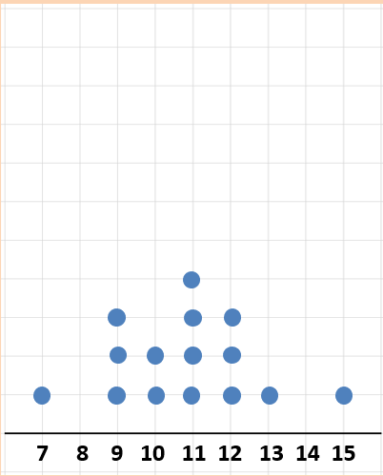
MMMR
How can we calculate mean, median, mode and range from this dot plot?
Mean:
Mode:
Median:
Range:

Slide 18
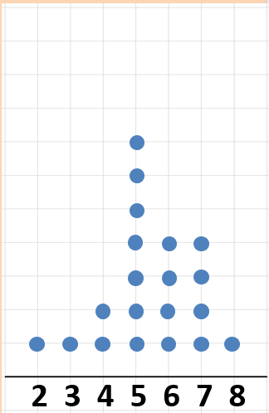
Whiteboards
Calculate
Mean
Median
Mode
Range

Slide 19
Skills practice
Complete the activity provided.

